Slide 1
上海五角场凯悦酒店
HYATT REGENCY
SHANGHAI, WUJIAOCHANG

Slide 2
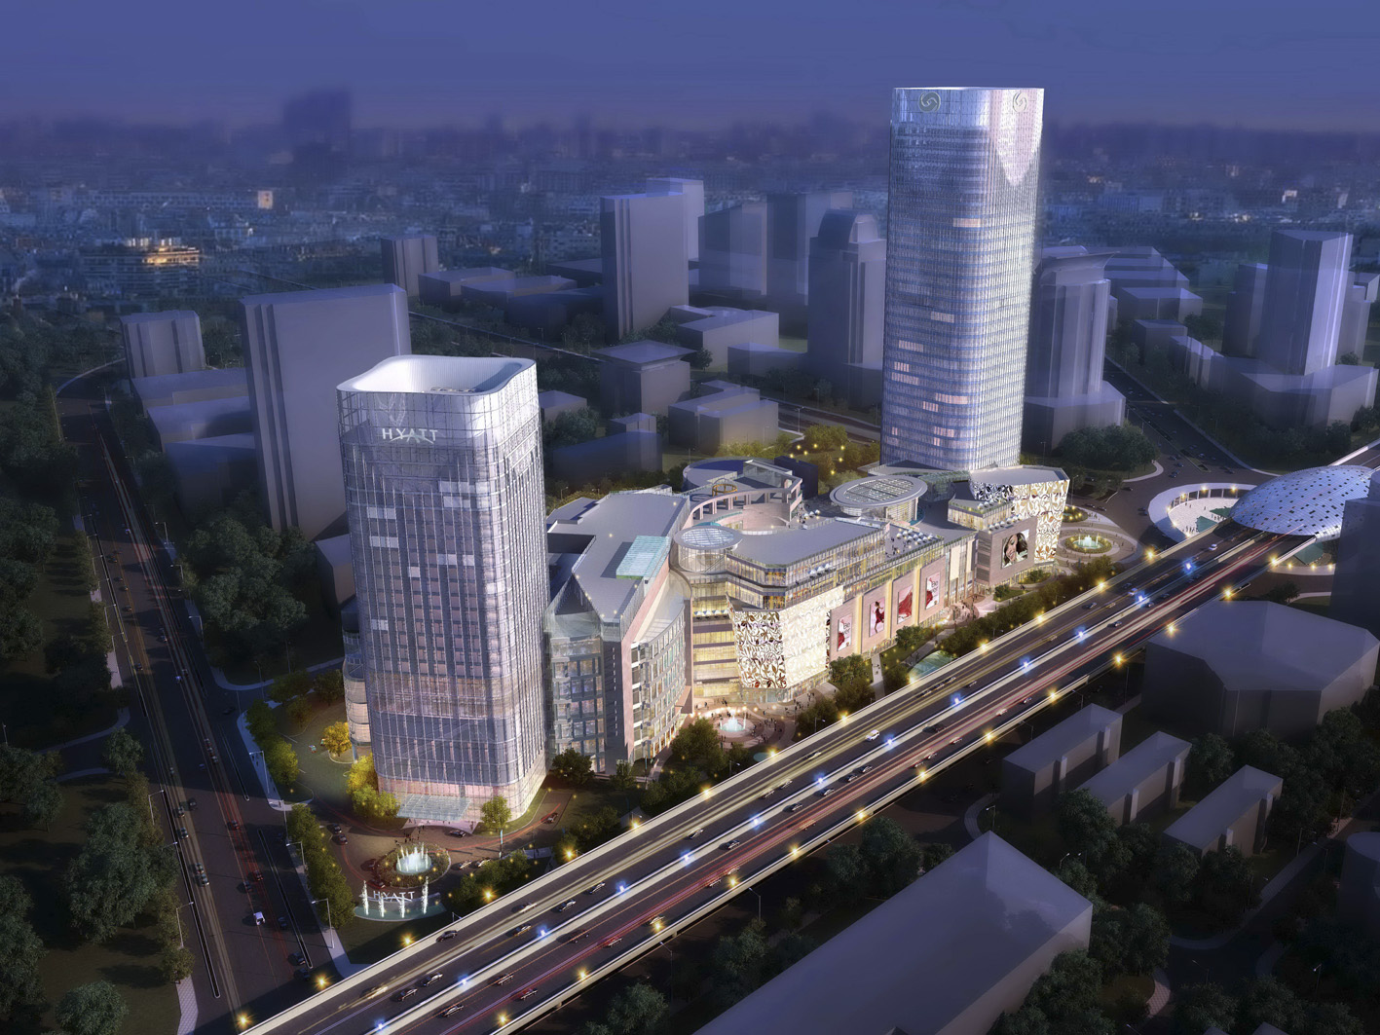

Slide 3
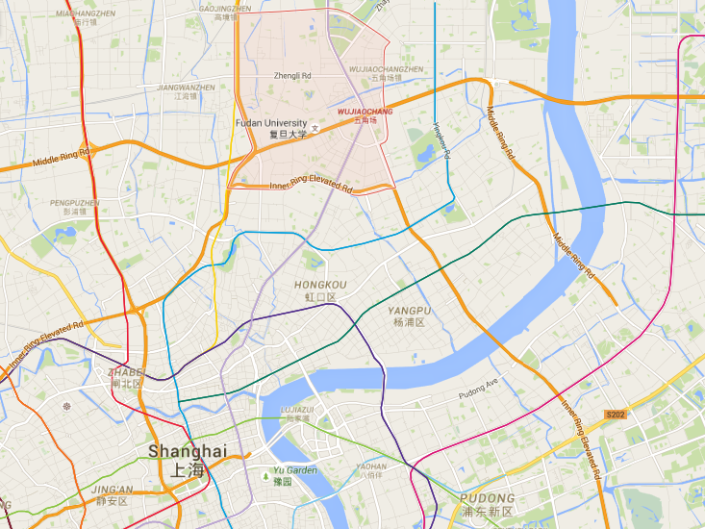
区域地理
GEOGRAPHY
五角场
Wujiaochang
杨浦五角场城市副中心南部环岛地块是市政府确定的上海十大商业中心之一，和徐家汇、淮海中路、中山公园等商业中心并称。同时五角场也已经与徐家汇繁华商业副中心，浦东花木高尚居住副中心，普陀真如交通枢纽副中心并称为上海四大城市副中心区之一。五角场商圈已成为上海市近两年来人流最多、人气最旺的商圈之一。
The southern part of Yangpu, Wujiaochang District is one of Shanghai’s top ten commercial centers. Wujiaochang business zone has become one of the most popular area across the city in the past two years.

Slide 4
五角场概况
AREA HISTORY
五角场的历史悠久，因“翔殷路”、“黄兴路”、“四平路”“淞沪路”，“邯郸路”五条马路汇于中心，而得名五角场。现如今，该区域不仅商业繁荣，更是汇聚各类高等学府，例如复旦大学、同济大学、第二军医大学、上海财经大学、上海体育学院、及南京政治学院分院。
Wujiaochang has a storied history. The name means “The Hub of 5 Avenue”, since there are five important roads, Siping Road, Huangxing Road, Xiangyin Road, Songhu Road, and Handan Road, converge to the center of Wujiaochang area. Aside from being a busy business zone, Wujiaochang area is also the home to some of the country’s best educational institutes, namely Fudan University, Tongji University, Second Military Medical University, Shanghai University of Finance and Economics, and Shanghai University of Sport .

Slide 5
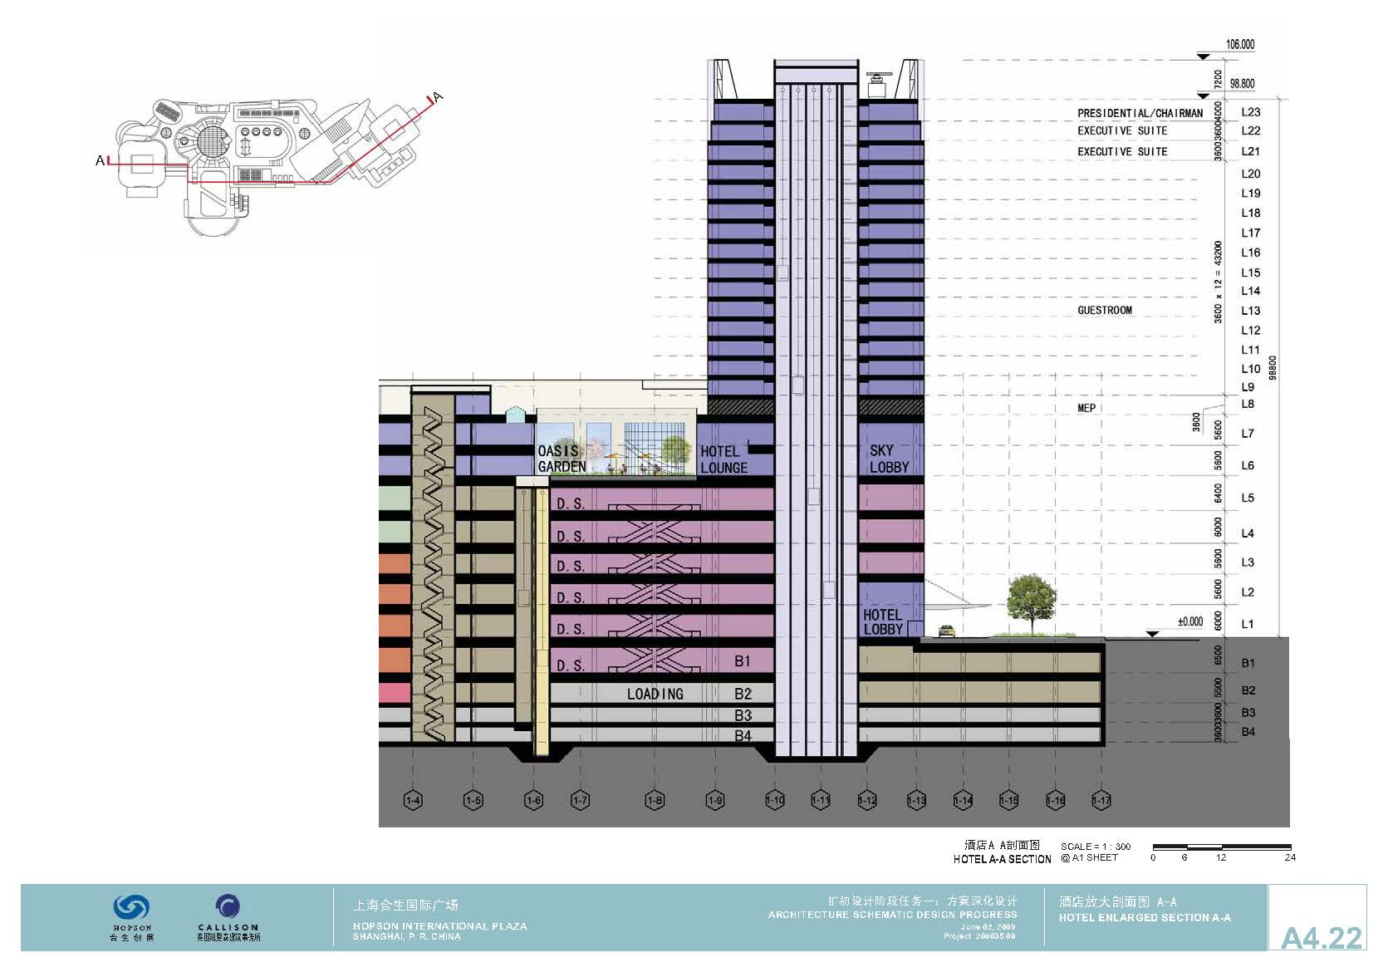
酒店概况
HOTEL OVERVIEW
Level 9- 25 –Guestrooms
Level 8 – Fitness Center
Level 7 – Ballroom
Level 6 – Reception, The Lounge,
Market Cafe, EVENTS
Shopping Mall
Level 1 – Arrival Lobby
B2 - B3 – BOH
酒店拥有306间舒适的现代客房。所有房间均可饱览五角场地区景观乃至上海美景。
室内恒温游泳池和24小时健身中心可供客人们随时保持良好的健身习惯。大堂吧和咖啡馆为客人们呈现各式各样的美食盛宴。
Our five-star property in Wujiaochang has 306 rooms and suites, an indoor swimming pool, 24-hour fitness center, and a range of dining options, mainly The Lounge and Market Café.

Slide 6
客房及套房
ROOMS & SUITES
Room Type | Number of Room | Square Meter
Regency King | 151 | 40
Regency Twin | 83 | 40
Club King | 27 | 40
Club Twin | 13 | 40
Club Deluxe King | 15 | 60
Regency Suite | 14 | 110
Regency Executive Suite | 2 | 130
Chairman Suite | 1 | 210
 | 306 (Suite % = 5.5 %)

Slide 7
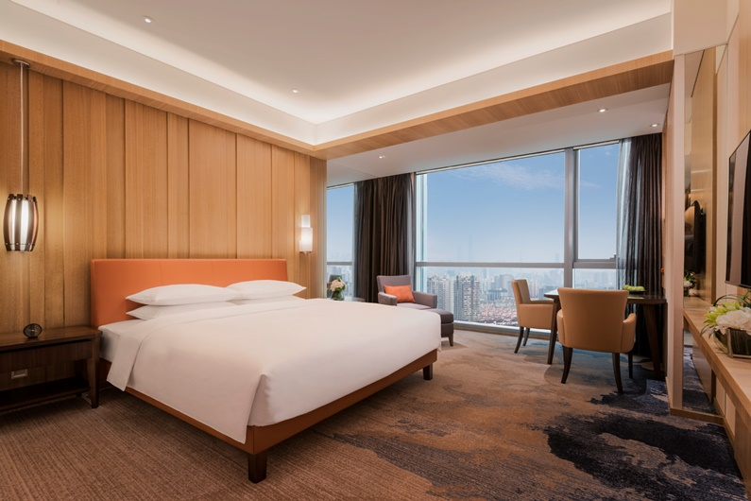
客房设施
ACCOMMODATION
酒店客房内皆配有高速有线和无线网络，48寸电视及卫星电视频道，移动式扩充口及超大办公桌，让您尽享超凡的入住感受。落地玻璃窗更是将城市美景一揽而尽。
All rooms and suites are equipped with high-speed Internet access, a 48-inch television and docking station. In addition, all rooms have an oversized work desk and Floor-to-ceiling windows that capture stunning views of the city.

Slide 8
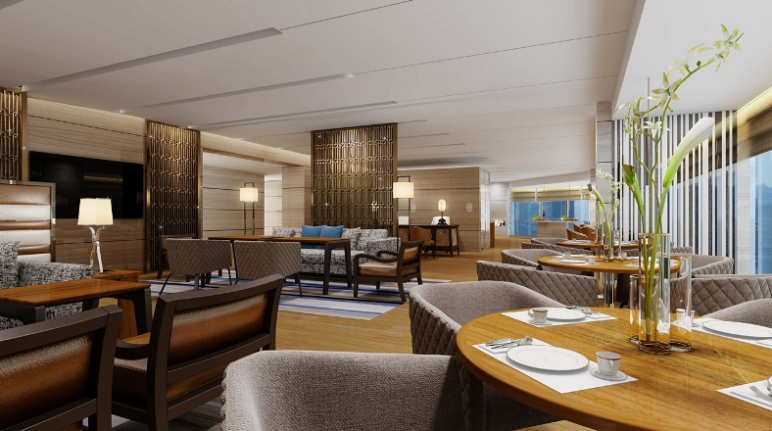
嘉宾轩
REGENCY CLUB
嘉宾轩位于酒店23层，专属的嘉宾轩酒廊每日提供免费欧陆式早餐，全天供应咖啡和茶、晚间的鸡尾酒及餐前小点。客人每次入住还可免费使用嘉宾轩会议室1小时。
Guests staying in Club Rooms and Suites can enjoy complimentary breakfast, evening cocktails and canapés, all-day self-served coffee and tea in the Club Lounge on the 23rd floor and one hour use of a Regency Club meeting room per stay.

Slide 9
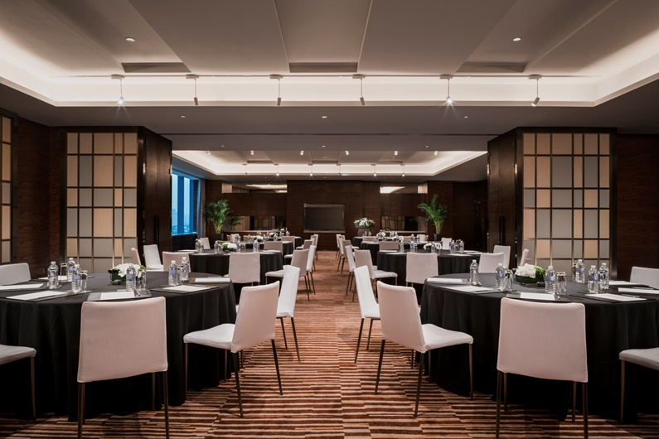
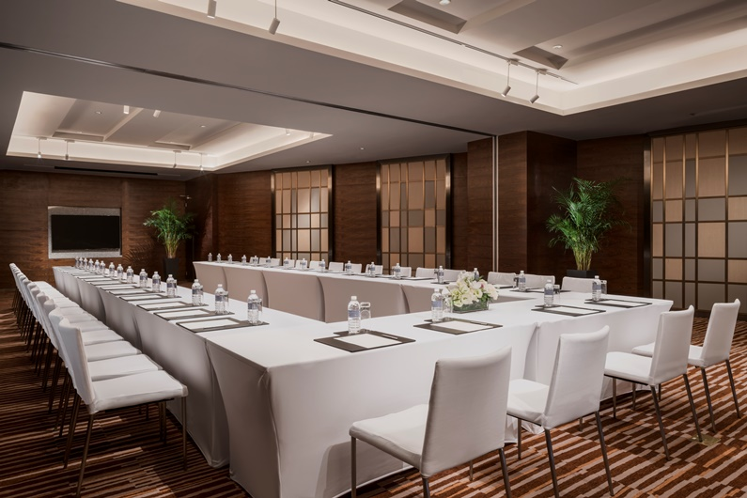
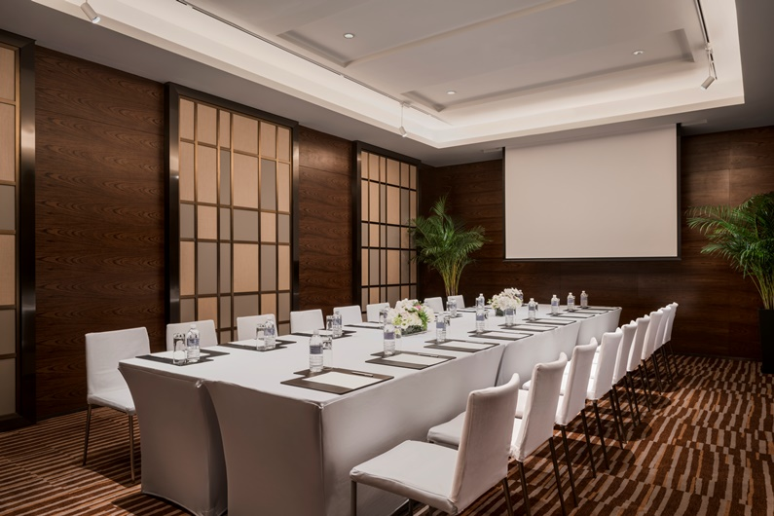
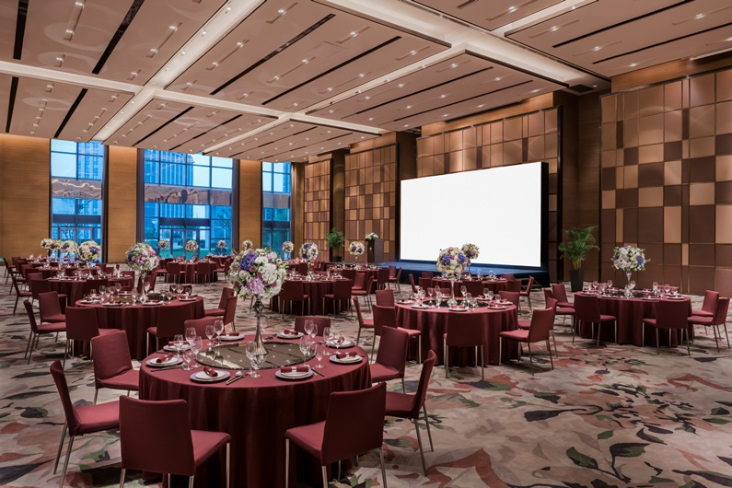
会议场所
MEETING SPACE
酒店拥有2,858平方米的会议宴会场地，并配有总面积达634平方米的7间多功能厅，是商务会议、宴会及婚礼活动的最佳选择。
Perfectly suited for quintessential events, meetings and conferences, the hotel offers 2,858 sqm of diverse and flexible meeting and event spaces, including 7 multi-function meeting rooms that has the total area of 634 sqm.

Slide 10
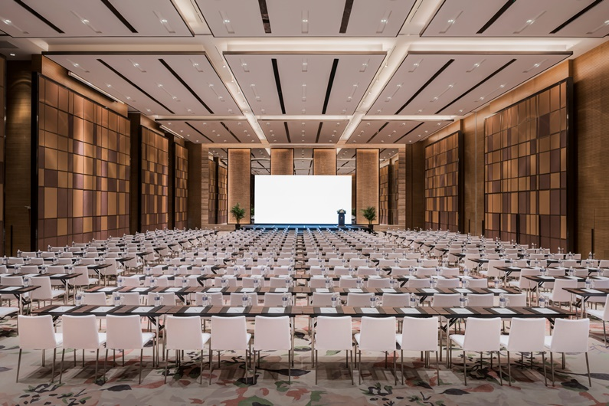
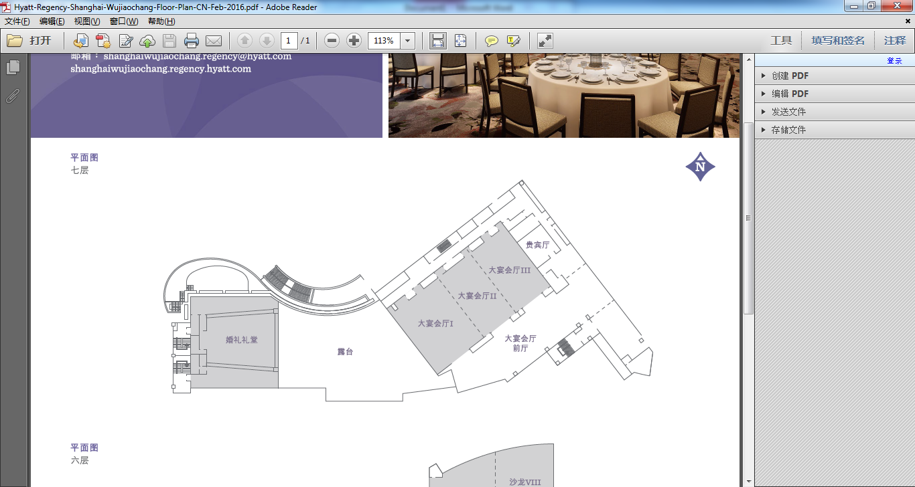
大宴会厅
REGENCY BALLROOM
沁亭
大宴会厅面积达774平方米，层高7.7米，一面为大幅落地玻璃，为大宴会厅提供了自然采光， 营造出深处大自然的意境体验。宴会厅紧连一个空中花园露台，500平方米的休息区及沁亭，窗外露台美景沁人心脾。
The spacious pillar-less Regency Ballroom is 774 sqm with 7.7 meter high ceiling. Thanks to the floor-to-ceiling glass window, the Ballroom is filled with natural light. Connecting with an outdoor terrace, a 500-square-meter pre-function space and a Glass House, the Ballroom puts the nature right besides you.

Slide 11
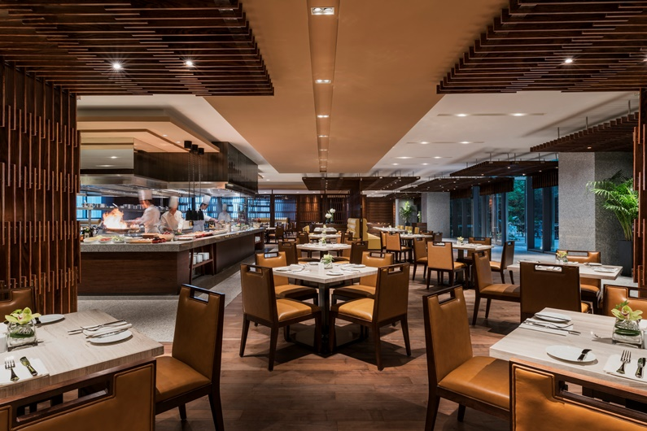
咖啡厅Market Café
No. of Seats 座位数:210
咖啡厅位于酒店6层，提供早、午、晚丰富多样的环球自助美食和零点。开放式厨房可以使您欣赏主厨们将新鲜的当季食材烹调成一道道让人垂涎欲滴的美食，大饱口福的同时，大饱眼福。
Located on Level 6, Market Café serves an extensive buffet selection during breakfast, lunch and dinner, plus an all-day a la carte menu of Asian, European-American and local Chinese cuisines. With the open kitchen, fresh seasonal ingredients are transformed into gourmet food right under your eyes.

Slide 12
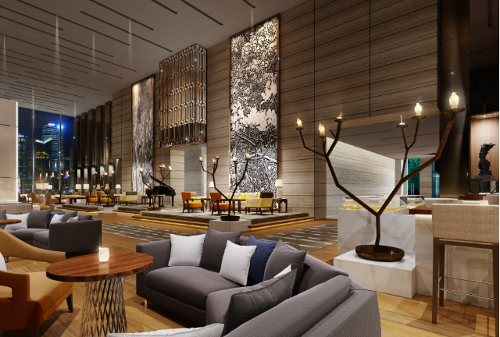
大堂吧 The Lounge
No. of Seats 座位数:96
位于酒店6层的大堂吧，完美呈现西式传统小食，精美下午茶及特选中西式饮品。融合了自然元素的装修风格让人犹如踏入了静谧的唯美绿洲，是休闲聚会的不二场所。
The Lounge is located on Level 6. With its nature-themed decorations, The Lounge is a memorable place for relaxing and socializing. It serves traditional Western light snacks as well as a selection of premium tea, coffee and other beverages.

Slide 13
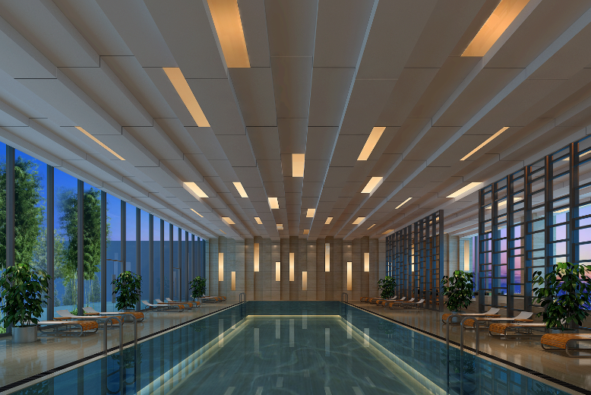
健身场所
FITNESS FACILITIES
酒店8层的室内恒温游泳池和24小时健身中心让客人放松身心，时刻保持健康的生活方式。
Located on Level 8, the indoor heated swimming pool and the 24-hour fitness center allow the guests to maintain a healthy lifestyle and relax from the busy city life.

Slide 14
THANK YOU
谢 谢！

